Slide 1
Chapter 4: The Building Blocks: Binary Numbers, Boolean Logic, and Gates
Invitation to Computer Science,
C++ Version, Third & Fourth Edition
Spring 2008: Additions by S. Steinfadt

Slide 2
Objectives
In this chapter, you will learn about:
The binary numbering system
Boolean logic and gates
Building computer circuits
Control circuits
Invitation to Computer Science, C++ Version, Third Edition

Slide 3
Introduction
Chapter 4 focuses on hardware design (also called logic design)
  How to represent and store information inside a computer
  How to use the principles of symbolic logic to design gates
  How to use gates to construct circuits that perform operations such as adding and comparing numbers, and fetching instructions
Invitation to Computer Science, C++ Version, Third Edition

Slide 4
The Binary Numbering System
A computer’s internal storage techniques are different from the way people represent information in daily lives
Information inside a digital computer is stored as a collection of binary data
Invitation to Computer Science, C++ Version, Third Edition

Slide 5
Binary Representation of Numeric and Textual Information
Binary numbering system
  Base-2
  Built from ones and zeros
  Each position is a power of 2
    1101 = 1 x 2³ + 1 x 2² + 0 x 2¹ + 1 x 2⁰
Decimal numbering system
  Base-10
  Each position is a power of 10
    3052 = 3 x 10³ + 0 x 10² + 5 x 10¹ + 2 x 10⁰
Invitation to Computer Science, C++ Version, Third Edition

Slide 6
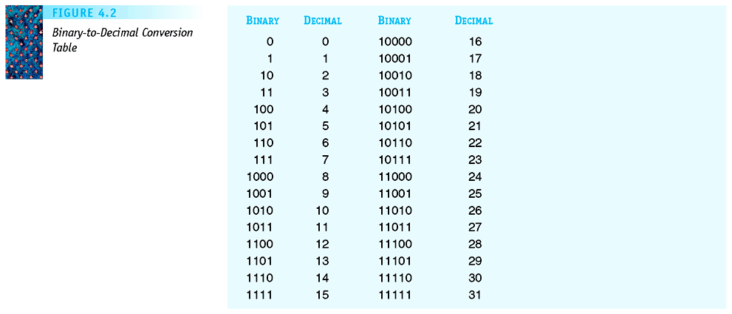
Figure 4.2
Binary-to-Decimal
Conversion Table
Invitation to Computer Science, C++ Version, Third Edition

Slide 7
Binary Representation of Numeric and Textual Information (continued)
Representing integers
  Decimal integers are converted to binary integers
  Given k bits, the largest unsigned integer is
  2^{k} - 1
    Given 4 bits, the largest is 2⁴-1 = 15
  Signed integers must also represent the sign (positive or negative) - Sign/Magnitude notation
Invitation to Computer Science, C++ Version, Third Edition
Notes:
Given 16 bits, the largest value represented is 65,535
2^0 + 2^1 + …. + 2^14 + 2^15 =111111111111111
Arithmetic Overflow: # exceeds maxiumum allowable value

Slide 8
Binary Representation of Numeric and Textual Information (continued)
Representing real numbers
  Real numbers may be put into binary scientific notation: a x 2^{b} (or ±M x B^{±E})
    Example: 101.11 x 2⁰
  Number then normalized so that first significant digit is immediately to the right of the binary point
    Example: .10111 x 2³
  Mantissa and exponent then stored
Invitation to Computer Science, C++ Version, Third Edition

Slide 9
Binary Representation of Numeric and Textual Information (continued)
Characters are mapped onto binary numbers
  ASCII code set
    8 bits per character; 256 character codes
  UNICODE code set
    16 bits per character; 65,536 character codes
Text strings are sequences of characters in some encoding
Invitation to Computer Science, C++ Version, Third Edition

Slide 10
Binary Representation of Textual Information (cont’d)
Decimal | Binary | Val.
48 | 00110000 | 0
49 | 00110001 | 1
50 | 00110010 | 2
51 | 00110011 | 3
52 | 00110100 | 4
53 | 00110101 | 5
54 | 00110110 | 6
55 | 00110111 | 7
56 | 00111000 | 8
57 | 00111001 | 9
58 | 00111010 | :
59 | 00111011 | ;
60 | 00111100 | <
61 | 00111101 | =
62 | 00111110 | >
63 | 00111111 | ?
64 | 01000000 | @
65 | 01000001 | A
66 | 01000010 | B
Dec. | Unicode | Charac.
0x30 | 0x0030 | [0]
0x31 | 0x0031 | [1]
0x32 | 0x0032 | [2]
0x33 | 0x0033 | [3]
0x34 | 0x0034 | [4]
0x35 | 0x0035 | [5]
0x36 | 0x0036 | [6]
0x37 | 0x0037 | [7]
0x38 | 0x0038 | [8]
0x39 | 0x0039 | [9]
0x3A | 0x003A | [:]
0x3B | 0x003B | [;]
0x3C | 0x003C | [<]
0x3D | 0x003D | [=]
0x3E | 0x003E | [>]
0x3F | 0x003F | [?]
0x40 | 0x0040 | [@]
0x41 | 0x0041 | [A]
0x42 | 0x0042 | [B]
ASCII
8 bits long
Unicode
16 bits long
Partial
listings
only!
Invitation to Computer Science, C++ Version, Third Edition

Slide 11
Binary Representation of Sound and Images
Multimedia data is sampled to store a digital form, with or without detectable differences
Representing sound data
  Sound data must be digitized for storage in a computer
  Digitizing means periodic sampling of amplitude values
Invitation to Computer Science, C++ Version, Third Edition
Notes:
Sound is analog information:
Are we digital or analog creatures??? The meter on any measurement equip. - can give approx with a needle or with digital numbers flickering?

Slide 12
Binary Representation of Sound and Images (continued)
  From samples, original sound may be approximated
  To improve the approximation:
    Sample more frequently (increase sampling rate)
    Use more bits for each sample value (↑ bit depth)
Invitation to Computer Science, C++ Version, Third Edition
Notes:
Amplitude: height of wave - measure of loudness
Period: T the time it takes for the wave to make one complete cycle
Frequency: f total number of cycles per unit time measured in cycles/second (f = 1/T)
Hertz: cycles/second

Slide 13
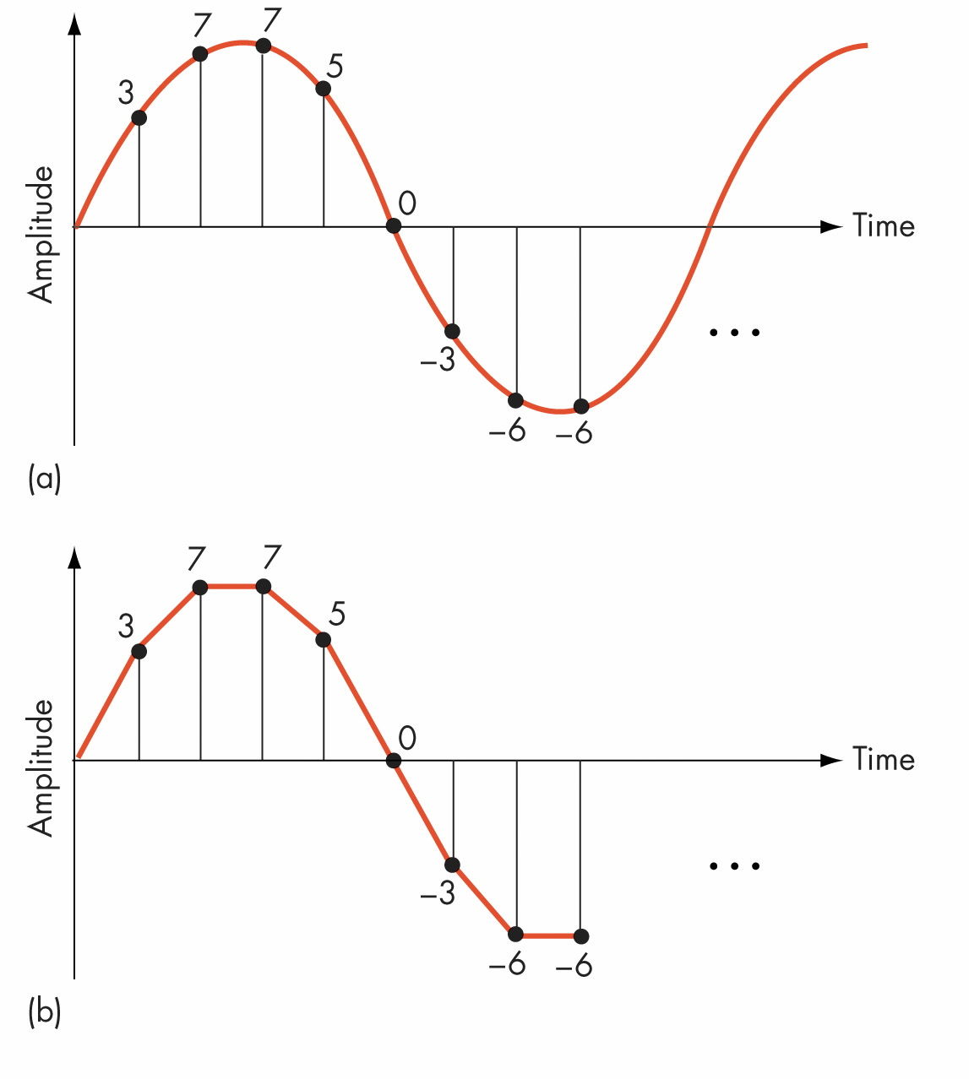
Figure 4.5
Digitization of an Analog Signal
(a) Sampling the Original
Signal
(b) Recreating the
Signal from the Sampled
Values
Invitation to Computer Science, C++ Version, Third Edition
Notes:
Human ear hears to about 20,000 hertz, to capture all, need to sample at 40,000 hertz

Slide 14
Binary Representation of Sound (cont’d)
MP3 format discussed in text, AAC format here
AAC (Advanced Audio Coding) advantages over MP3
  Improved compression provides higher-quality results with smaller file sizes
  Higher resolution audio, yielding sampling rates up to 96 kHz
  Improved decoding efficiency, requiring less processing power for decode
http://www.apple.com/quicktime/technologies/aac/
Invitation to Computer Science, C++ Version, Third Edition

Slide 15
Binary Representation of Sound and Images (continued)
Representing image data
  Images are sampled by reading color and intensity values at even intervals across the image
  Each sampled point is a pixel
  Image quality depends on number of bits at each pixel
Invitation to Computer Science, C++ Version, Third Edition

Slide 16
Binary Representation of Images (cont’d)
Representing image data
  Images are sampled by reading color and intensity values at even intervals across the image
  Each sampled point is a pixel
  Image quality depends on number of bits at each pixel
  More image information: http://cat.xula.edu/tutorials/imaging/grayscale.php
Invitation to Computer Science, C++ Version, Third Edition

Slide 17
The Reliability of Binary Representation
Electronic devices are most reliable in a bistable environment
Bistable environment
  Distinguishing only two electronic states
    Current flowing or not
    Direction of flow
Computers are bistable: hence binary representations
Invitation to Computer Science, C++ Version, Third Edition
Notes:
Voltage lvl. Corresponds to decimal digit
+0 0
+5 1 Hardware Req’mts
+10 2 1. 2 stable energy states
+15 3 2. 2 states separated by large
+20 4 energy barrier
+25 5 3. Possible sense state of dev.
+30 6 4. Possible to switch from one
+35 7 state to the other
+40 8
+45 9

Slide 18
Binary Storage Devices
Magnetic core
  Historic device for computer memory
  Tiny magnetized rings: flow of current sets the direction of magnetic field
  Binary values 0 and 1 are represented using the direction of the magnetic field
Invitation to Computer Science, C++ Version, Third Edition

Slide 19
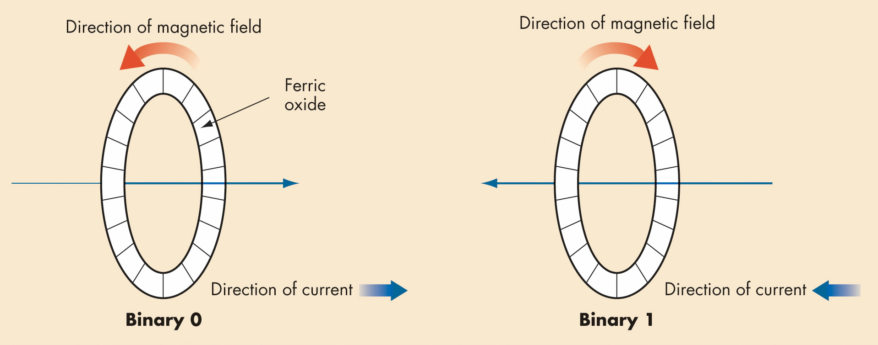
Figure 4.9
Using Magnetic Cores to Represent Binary Values
Invitation to Computer Science, C++ Version, Third Edition
Notes:
512 MB = 512 million bytes (+4 billion bits)
8 million sq. in = 230 ft. (over 20 stories high!)

Slide 20
Binary Storage Devices (continued)
Transistors
  Solid-state switches: either permits or blocks current flow
  A control input causes state change
  Constructed from semiconductors
Invitation to Computer Science, C++ Version, Third Edition

Slide 21
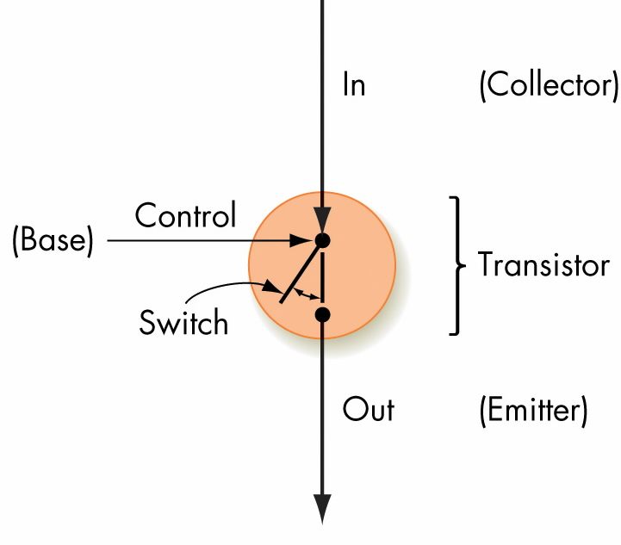
Figure 4.11
Simplified Model of a Transistor
Invitation to Computer Science, C++ Version, Third Edition

Slide 22
Boolean Logic and Gates: Boolean Logic
Boolean logic describes operations on true/false values
True/false maps easily onto bistable environment
Boolean logic operations on electronic signals may be built out of transistors and other electronic devices
Invitation to Computer Science, C++ Version, Third Edition

Slide 23
Boolean Logic (continued)
Boolean operations
  a AND b
    True only when a is true and b is true
  a OR b
    True when either a is true or b is true, or both are true
  NOT a
    True when a is false, and vice versa
Invitation to Computer Science, C++ Version, Third Edition

Slide 24
Boolean Logic (continued)
Boolean expressions
  Constructed by combining together Boolean operations
    Example: (a AND b) OR ((NOT b) AND (NOT a))
Truth tables capture the output/value of a Boolean expression
  A column for each input plus the output
  A row for each combination of input values
Invitation to Computer Science, C++ Version, Third Edition

Slide 25
Boolean Logic (continued)
Example:
  (a AND b) OR ((NOT b) and (NOT a))
a | b | Value
0 | 0 | 1
0 | 1 | 0
1 | 0 | 0
1 | 1 | 1
Invitation to Computer Science, C++ Version, Third Edition

Slide 26
Gates
Gates
  Hardware devices built from transistors to mimic Boolean logic
AND gate
  Two input lines, one output line
  Outputs a 1 when both inputs are 1
Invitation to Computer Science, C++ Version, Third Edition

Slide 27
Gates (continued)
OR gate
  Two input lines, one output line
  Outputs a 1 when either input is 1
NOT gate
  One input line, one output line
  Outputs a 1 when input is 0 and vice versa
Invitation to Computer Science, C++ Version, Third Edition

Slide 28
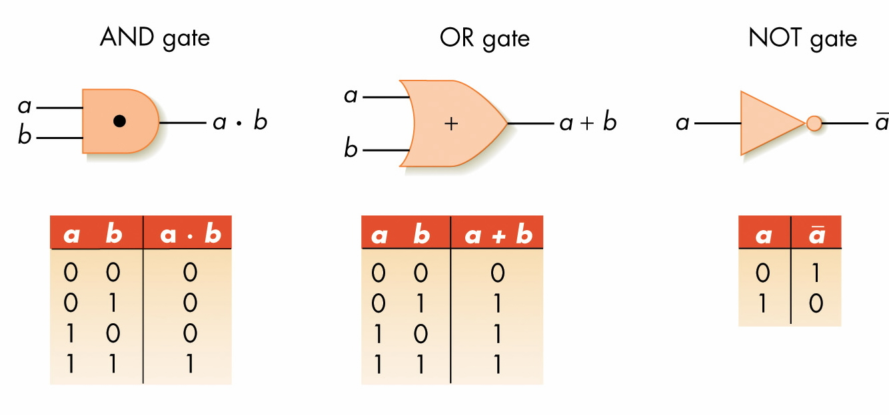
Figure 4.15
The Three Basic Gates and Their Symbols
Invitation to Computer Science, C++ Version, Third Edition

Slide 29
Gates (continued)
Abstraction in hardware design
  Map hardware devices to Boolean logic
  Design more complex devices in terms of logic, not electronics
  Conversion from logic to hardware design may be automated
Invitation to Computer Science, C++ Version, Third Edition

Slide 30
Building Computer Circuits: Introduction
A circuit is a collection of logic gates:
  Transforms a set of binary inputs into a set of binary outputs
  Values of the outputs depend only on the current values of the inputs
Combinational circuits have no cycles in them (no outputs feed back into their own inputs)
Invitation to Computer Science, C++ Version, Third Edition

Slide 31
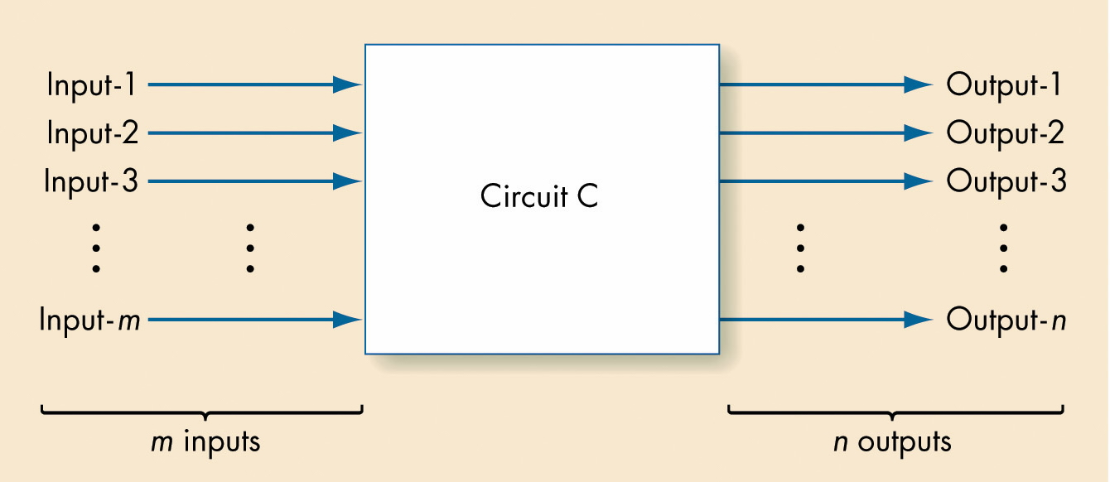
Figure 4.19
Diagram of a Typical Computer Circuit
Invitation to Computer Science, C++ Version, Third Edition

Slide 32
A Circuit Construction Algorithm
Sum-of-products algorithm is one way to design circuits:
  Truth table to Boolean expression to gate layout
Invitation to Computer Science, C++ Version, Third Edition

Slide 33
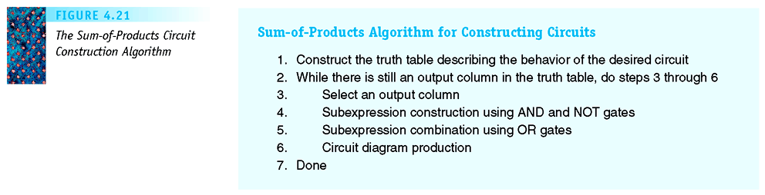
Figure 4.21
The Sum-of-Products Circuit Construction Algorithm
Invitation to Computer Science, C++ Version, Third Edition

Slide 34
A Circuit Construction Algorithm (continued)
Sum-of-products algorithm
  Truth table captures every input/output possible for circuit
  Repeat process for each output line
    Build a Boolean expression using AND and NOT for each 1 of the output line
    Combine together all the expressions with ORs
    Build circuit from whole Boolean expression
Invitation to Computer Science, C++ Version, Third Edition

Slide 35
Examples Of Circuit Design And Construction
Compare-for-equality circuit
Addition circuit
Both circuits can be built using the sum-of-products algorithm
Invitation to Computer Science, C++ Version, Third Edition

Slide 36
A Compare-for-equality Circuit
Compare-for-equality circuit
  CE compares two unsigned binary integers for equality
  Built by combining together 1-bit comparison circuits (1-CE)
  Integers are equal if corresponding bits are equal (AND together 1-CD circuits for each pair of bits)
Invitation to Computer Science, C++ Version, Third Edition

Slide 37
A Compare-for-equality Circuit (continued)
1-CE circuit truth table
a | b | Output
0 | 0 | 1
0 | 1 | 0
1 | 0 | 0
1 | 1 | 1
Invitation to Computer Science, C++ Version, Third Edition

Slide 38
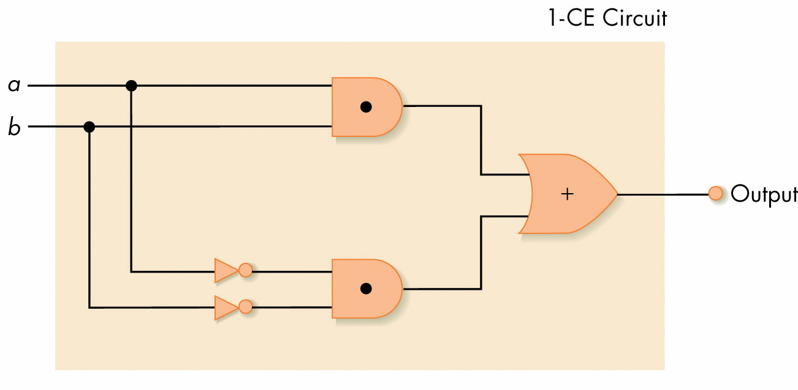
Figure 4.22
One-Bit Compare for Equality Circuit
Invitation to Computer Science, C++ Version, Third Edition

Slide 39
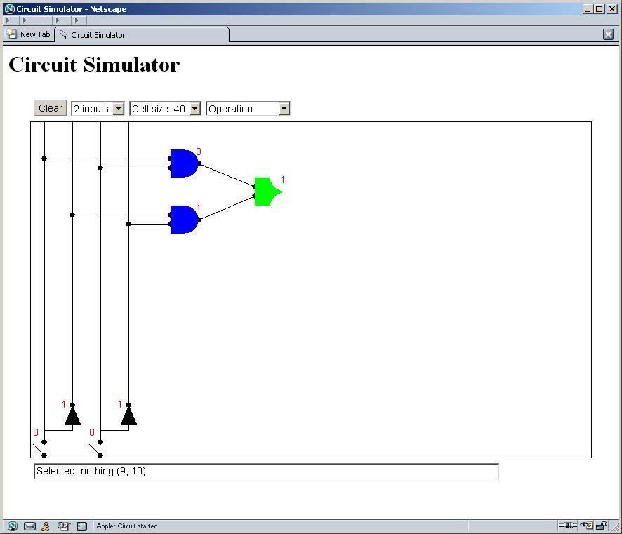
One-bit Compare for Equality Circuit (“Lab” Version)
One bit Compare for
Equality Circuit (Lab
Version)
Invitation to Computer Science, C++ Version, Third Edition

Slide 40
A Compare-for-equality Circuit (continued)
1-CE Boolean expression
  First case: (NOT a) AND (NOT b)
  Second case: a AND b
  Combined:
    ((NOT a) AND (NOT b)) OR (a AND b)
Invitation to Computer Science, C++ Version, Third Edition

Slide 41
An Addition Circuit
Addition circuit
  Adds two unsigned binary integers, setting output bits and an overflow
  Built from 1-bit adders (1-ADD)
  Starting with rightmost bits, each pair produces
    A value for that order
    A carry bit for next place to the left
Invitation to Computer Science, C++ Version, Third Edition

Slide 42
An Addition Circuit (continued)
1-ADD truth table
  Input
    One bit from each input integer
    One carry bit (always zero for rightmost bit)
  Output
    One bit for output place value
    One “carry” bit
Invitation to Computer Science, C++ Version, Third Edition

Slide 43
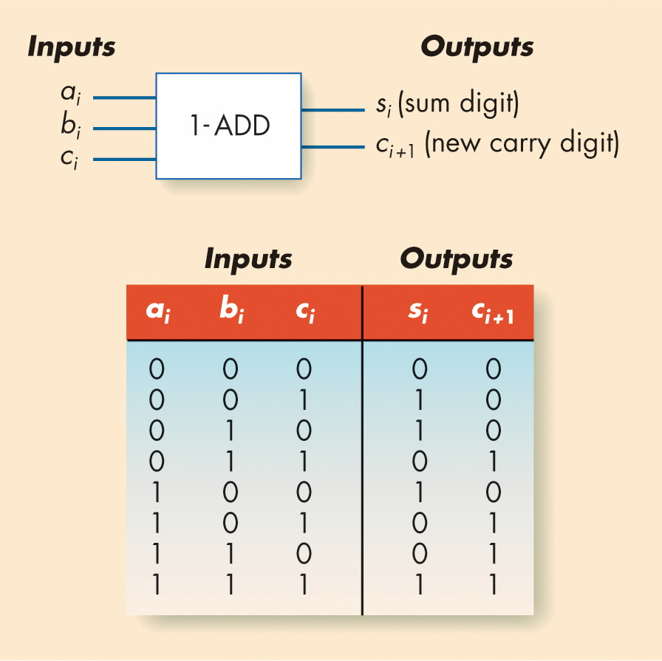
Figure 4.24
The 1-ADD Circuit and Truth Table
Invitation to Computer Science, C++ Version, Third Edition

Slide 44
An Addition Circuit (continued)
Building the full adder
  Put rightmost bits into 1-ADD, with zero for the input carry
  Send 1-ADD’s output value to output, and put its carry value as input to 1-ADD for next bits to left
  Repeat process for all bits
Invitation to Computer Science, C++ Version, Third Edition

Slide 45
Control Circuits
Do not perform computations
Choose order of operations or select among data values
Major types of controls circuits
  Multiplexors
    Select one of inputs to send to output
  Decoders
    Sends a 1 on one output line, based on what input line indicates
Invitation to Computer Science, C++ Version, Third Edition

Slide 46
Control Circuits (continued)
Multiplexor form
  2^{N} regular input lines
  N selector input lines
  1 output line
Multiplexor purpose
  Given a code number for some input, selects that input to pass along to its output
  Used to choose the right input value to send to a computational circuit
Invitation to Computer Science, C++ Version, Third Edition

Slide 47
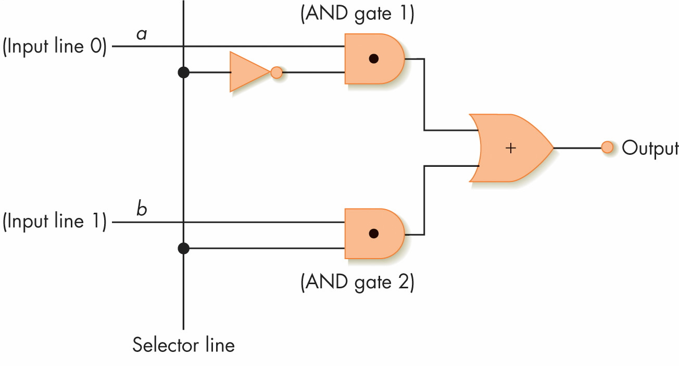
Figure 4.28
A Two-Input Multiplexor Circuit
Invitation to Computer Science, C++ Version, Third Edition

Slide 48
Control Circuits (continued)
Decoder
  Form
    N input lines
    2^{N} output lines
  N input lines indicate a binary number, which is used to select one of the output lines
  Selected output sends a 1, all others send 0
Invitation to Computer Science, C++ Version, Third Edition

Slide 49
Control Circuits (continued)
Decoder purpose
  Given a number code for some operation, trigger just that operation to take place
  Numbers might be codes for arithmetic: add, subtract, etc.
  Decoder signals which operation takes place next
Invitation to Computer Science, C++ Version, Third Edition

Slide 50
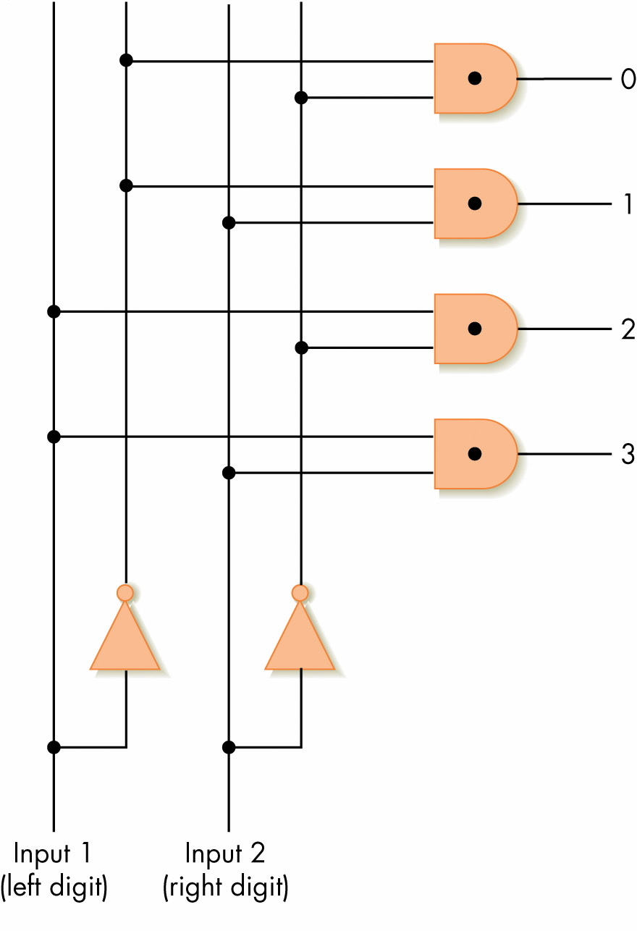
Figure 4.29
A 2-to-4 Decoder Circuit
Invitation to Computer Science, C++ Version, Third Edition

Slide 51
Summary
Digital computers use binary representations of data: numbers, text, multimedia
Binary values create a bistable environment, making computers reliable
Boolean logic maps easily onto electronic hardware
Circuits are constructed using Boolean expressions as an abstraction
Computational and control circuits may be built from Boolean gates
Invitation to Computer Science, C++ Version, Third Edition

